Slide 1






S25' Training Sessions
Mobile App
SESSION 7
#create_share_innovate

Slide 2







Table of contenet
Task Evaluation
recap
Icons
S25' Training Sessions
Statefull
Buttons
Assets
TextField

Slide 3



Task Evaluation
S25' Training Sessions
Task Evaluation

Slide 4
Recap
S25' Training Sessions
Quick recap
Notes:
Asking Questions or making kahoot

Slide 5
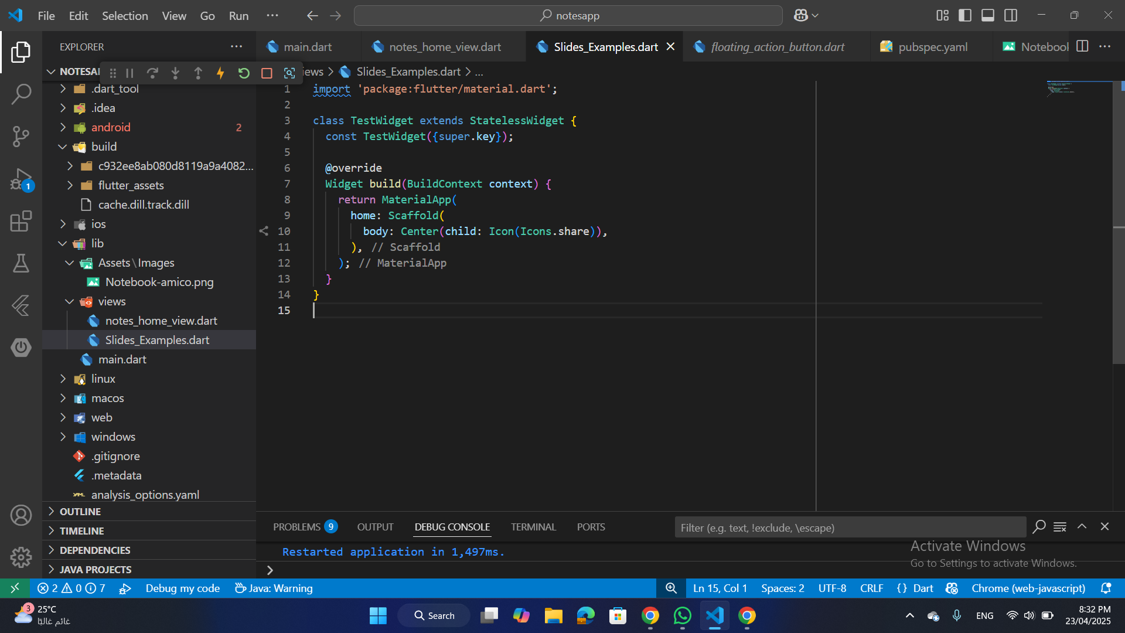
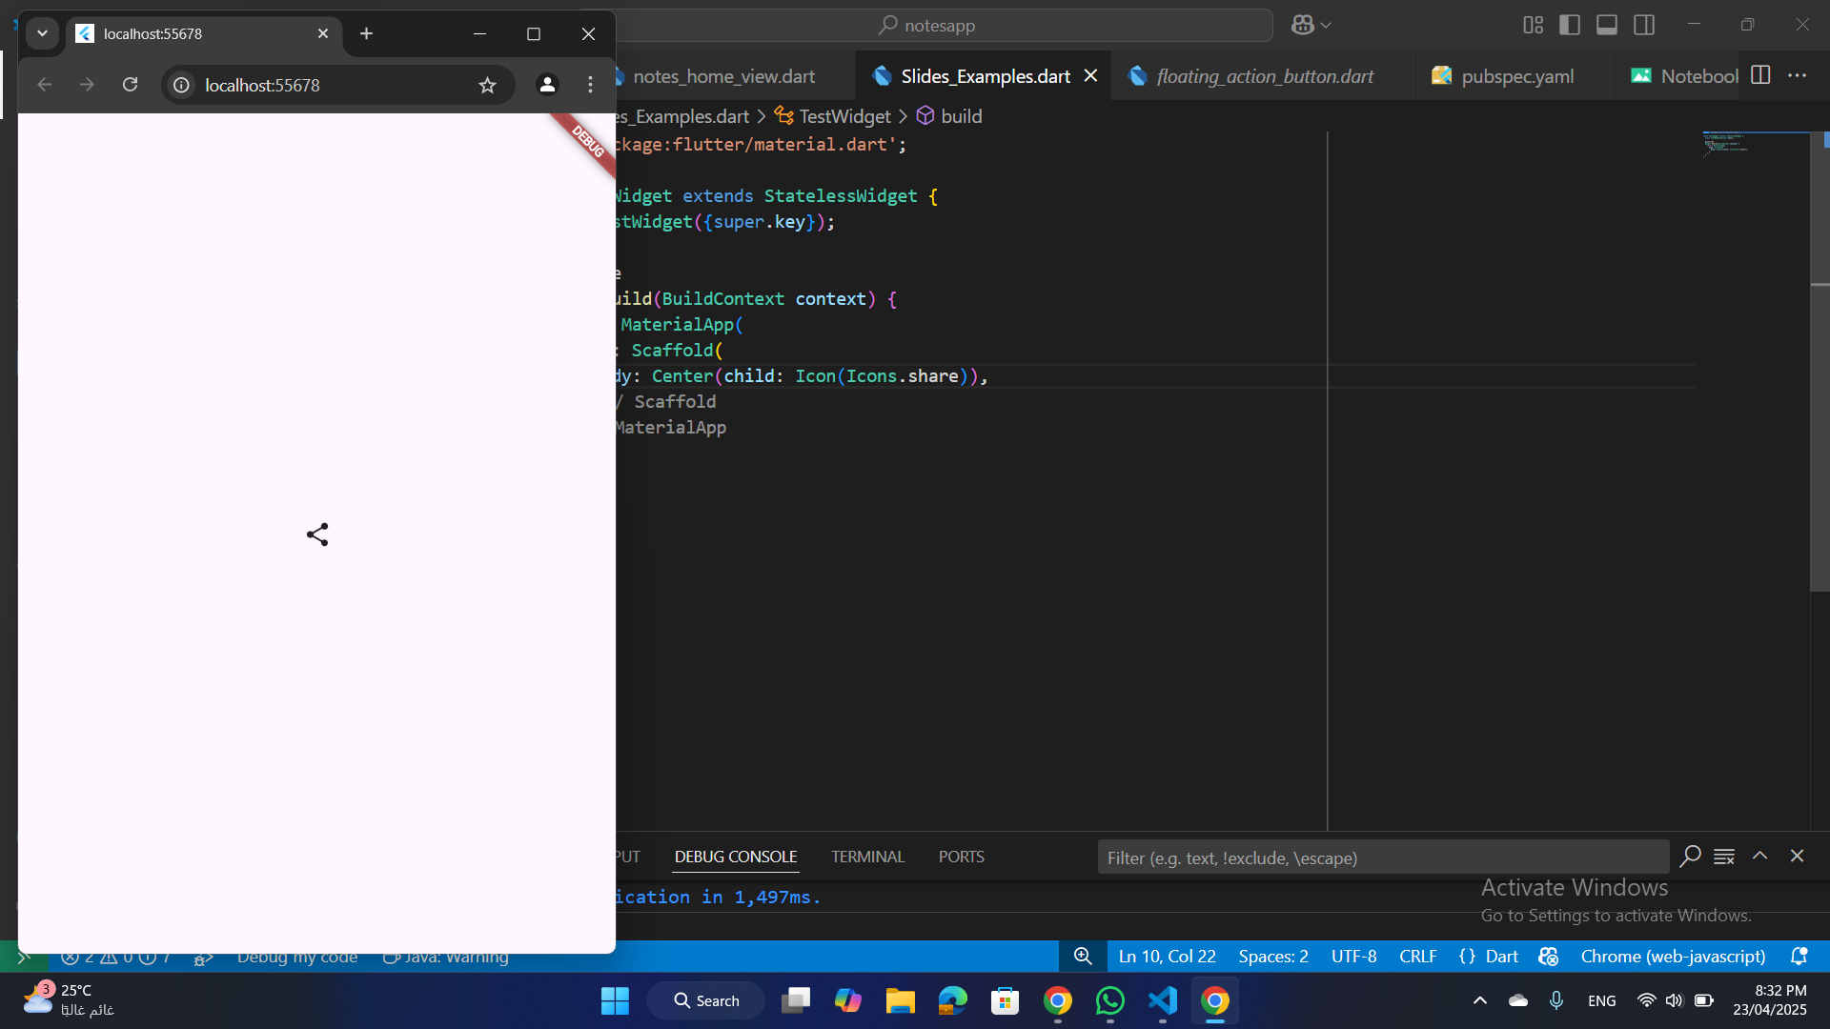
Icons
1.Basic Icon:
S25' Training Sessions

Slide 6
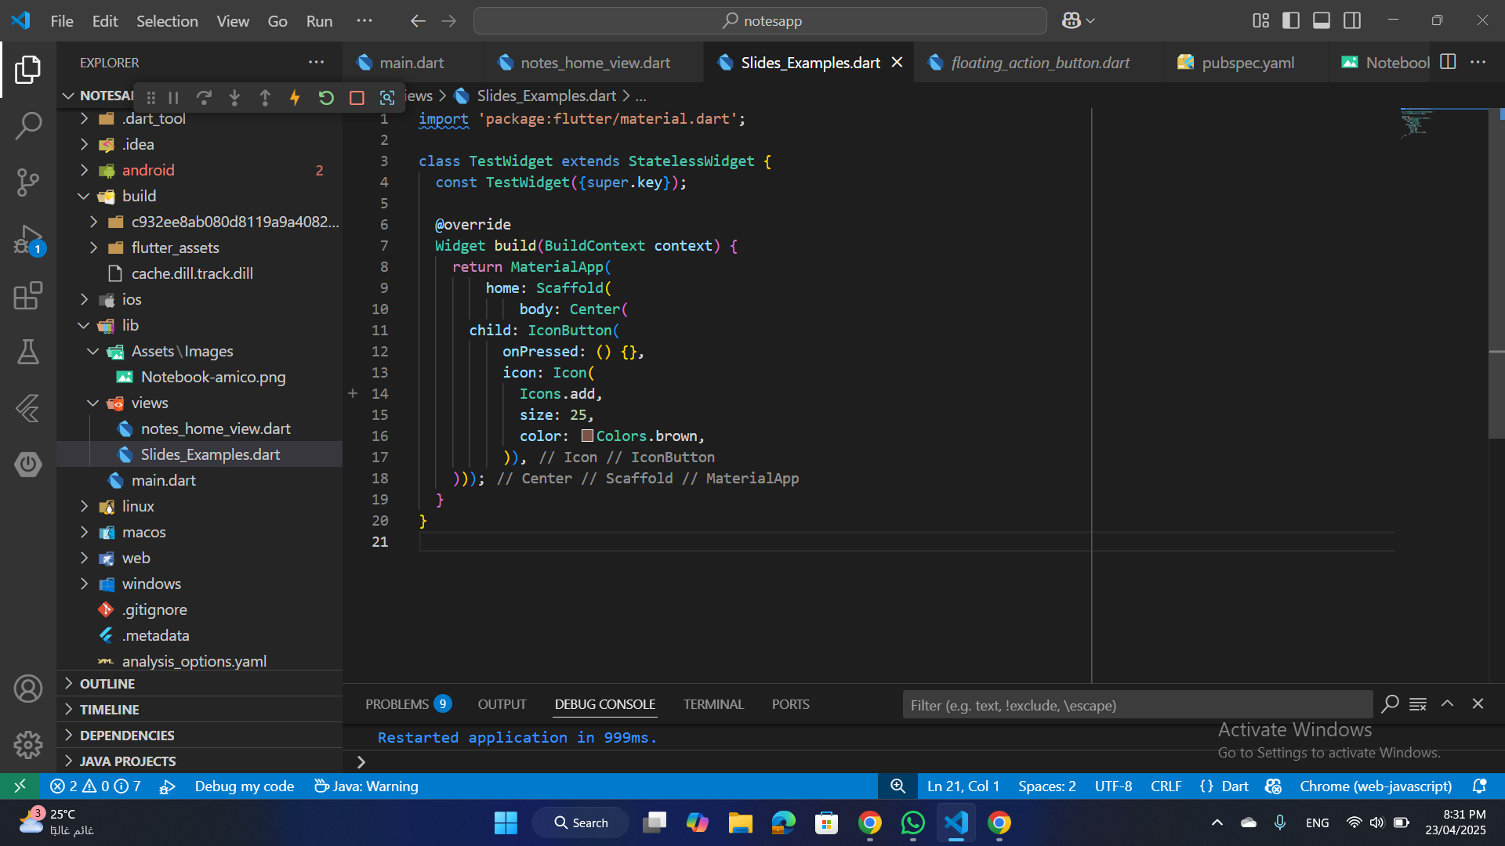
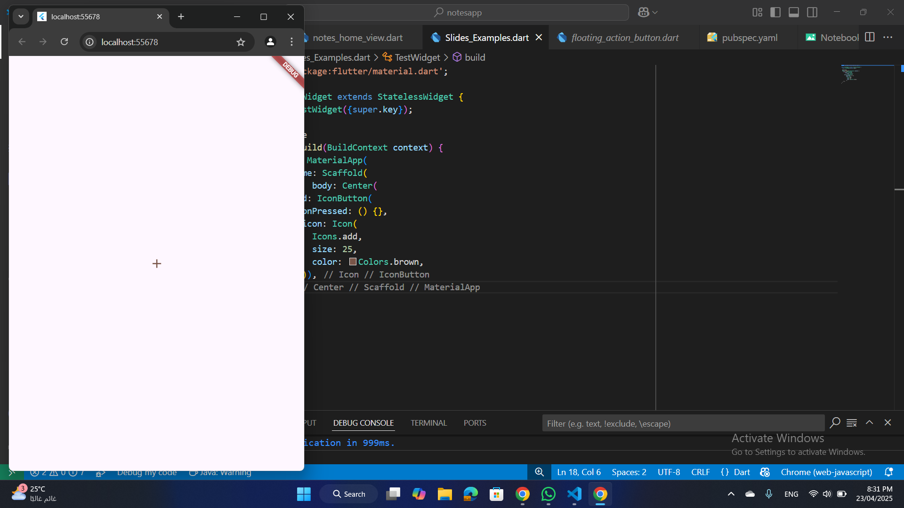
Icons
2.Icon Button
S25' Training Sessions

Slide 7
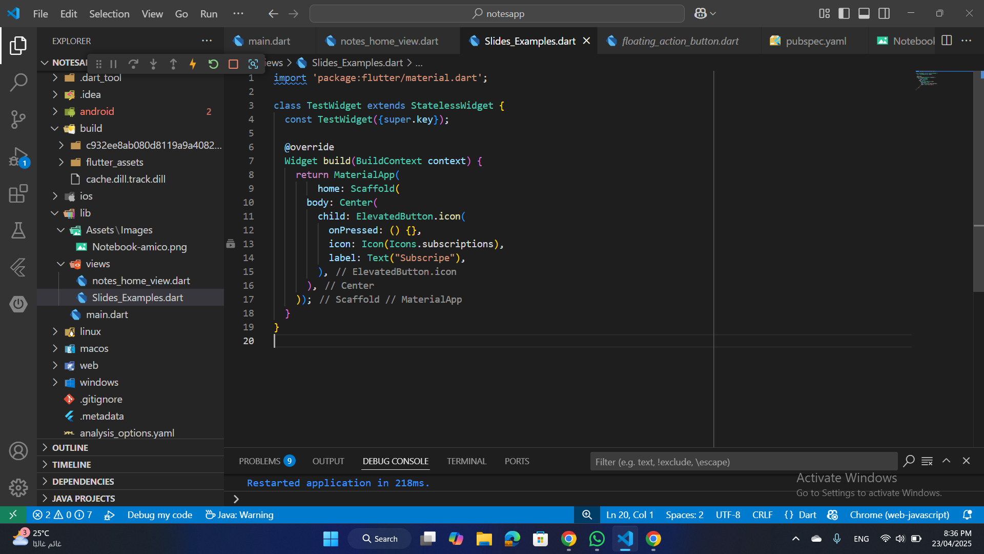
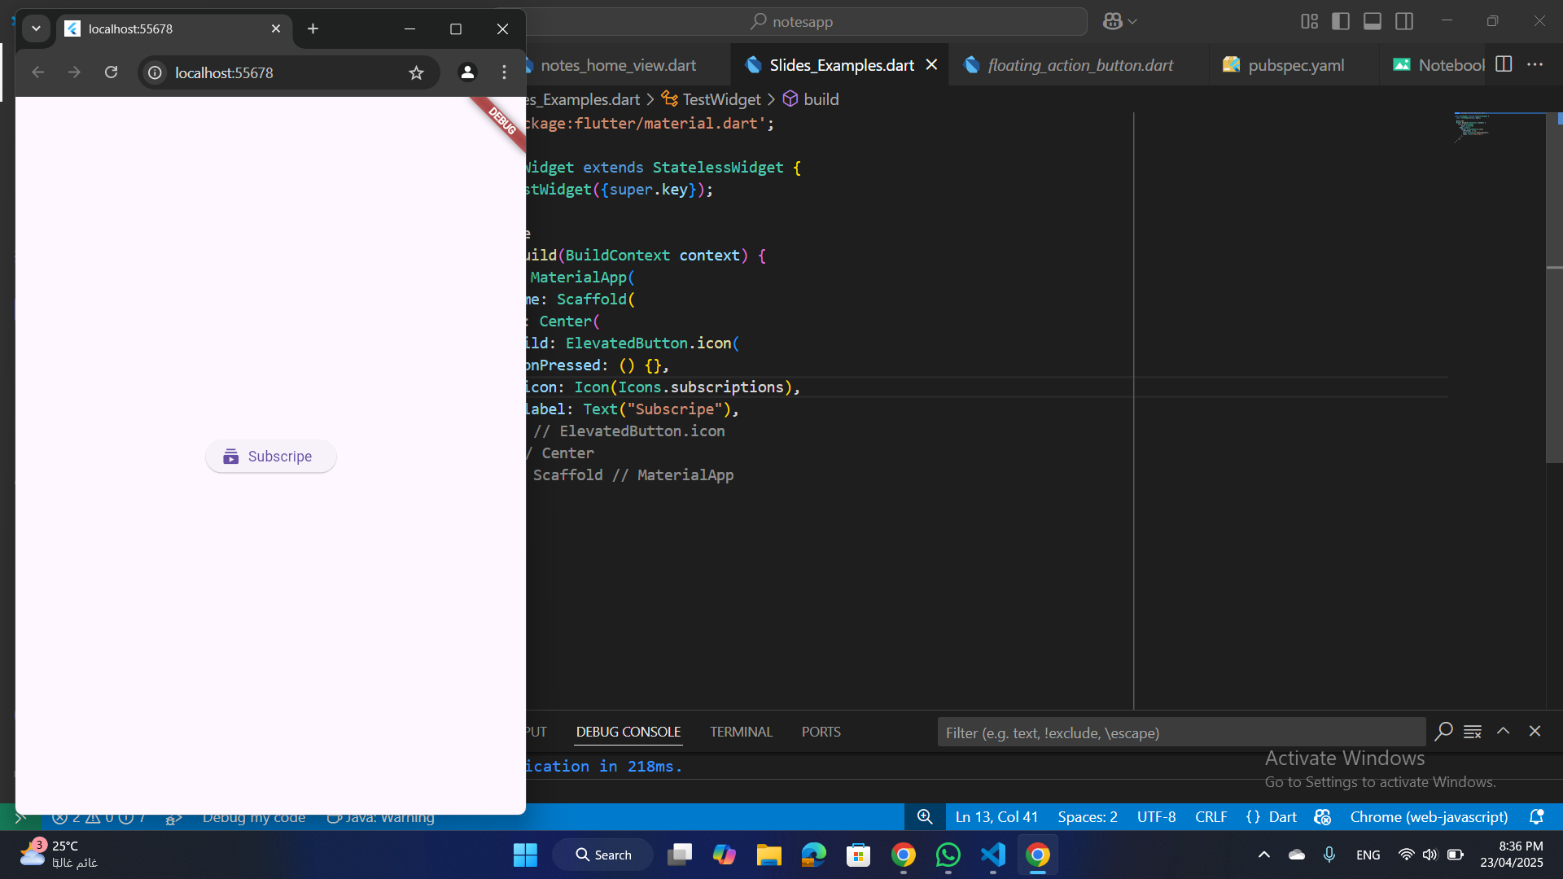
icons
3-Combining Icon and Text
S25' Training Sessions

Slide 8
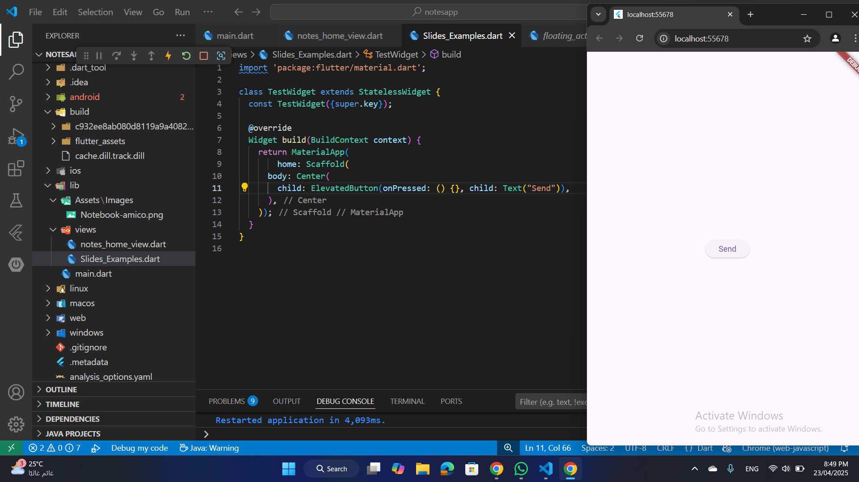
Buttons
ElevatedButton:
A material design button that elevates when pressed. It's often used for important actions, like submitting forms or navigating to another screen.
S25' Training Sessions

Slide 9
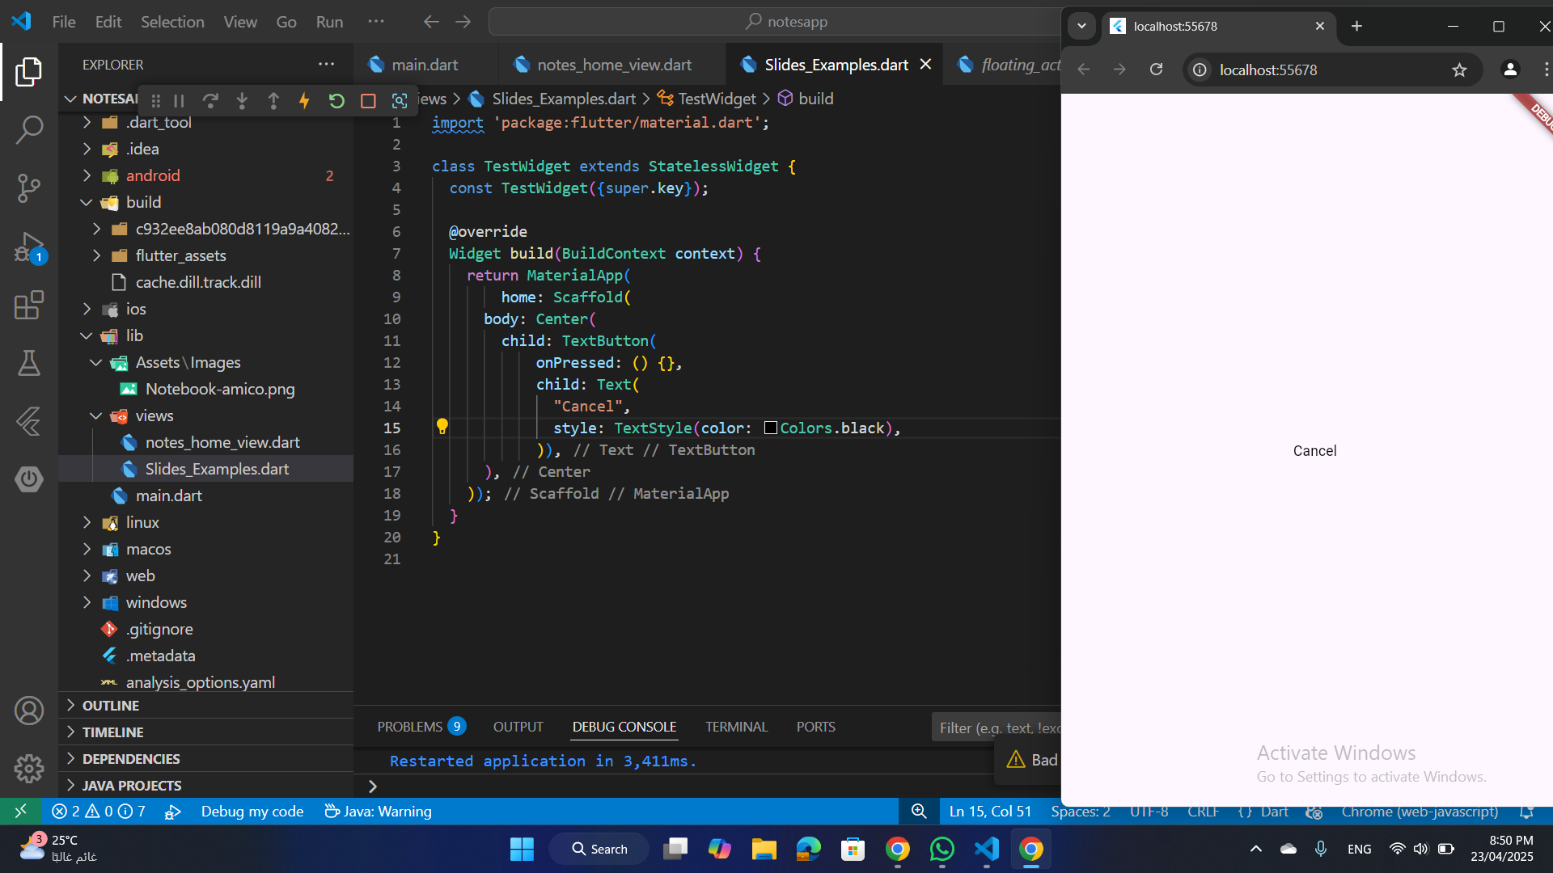
Buttons
TextButton:
A flat button with no elevation, typically used for secondary actions like “Cancel” or “Learn More”.
S25' Training Sessions

Slide 10

Buttons
OutlinedButton:
Similar to TextButton, but with an outline border. It’s useful for secondary actions when you want a more defined boundary.
S25' Training Sessions

Slide 11
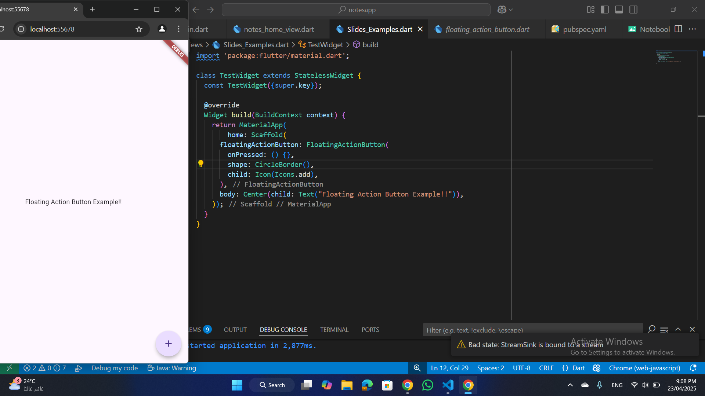
Buttons
FloatingActionButton:
A circular button that floats above content. It’s often used for the most important action on a screen, such as adding or creating something.
S25' Training Sessions

Slide 12
Assets
In Flutter, assets are files that are bundled and included with your app package. These can be images, fonts, JSON files, icons, or any other files your app needs to work properly or look the way you want.
S25' Training Sessions
Common Types of Assets in Flutter:
Images
Fonts
Text files (e.g., .json, .txt)
Audio or video files

Slide 13
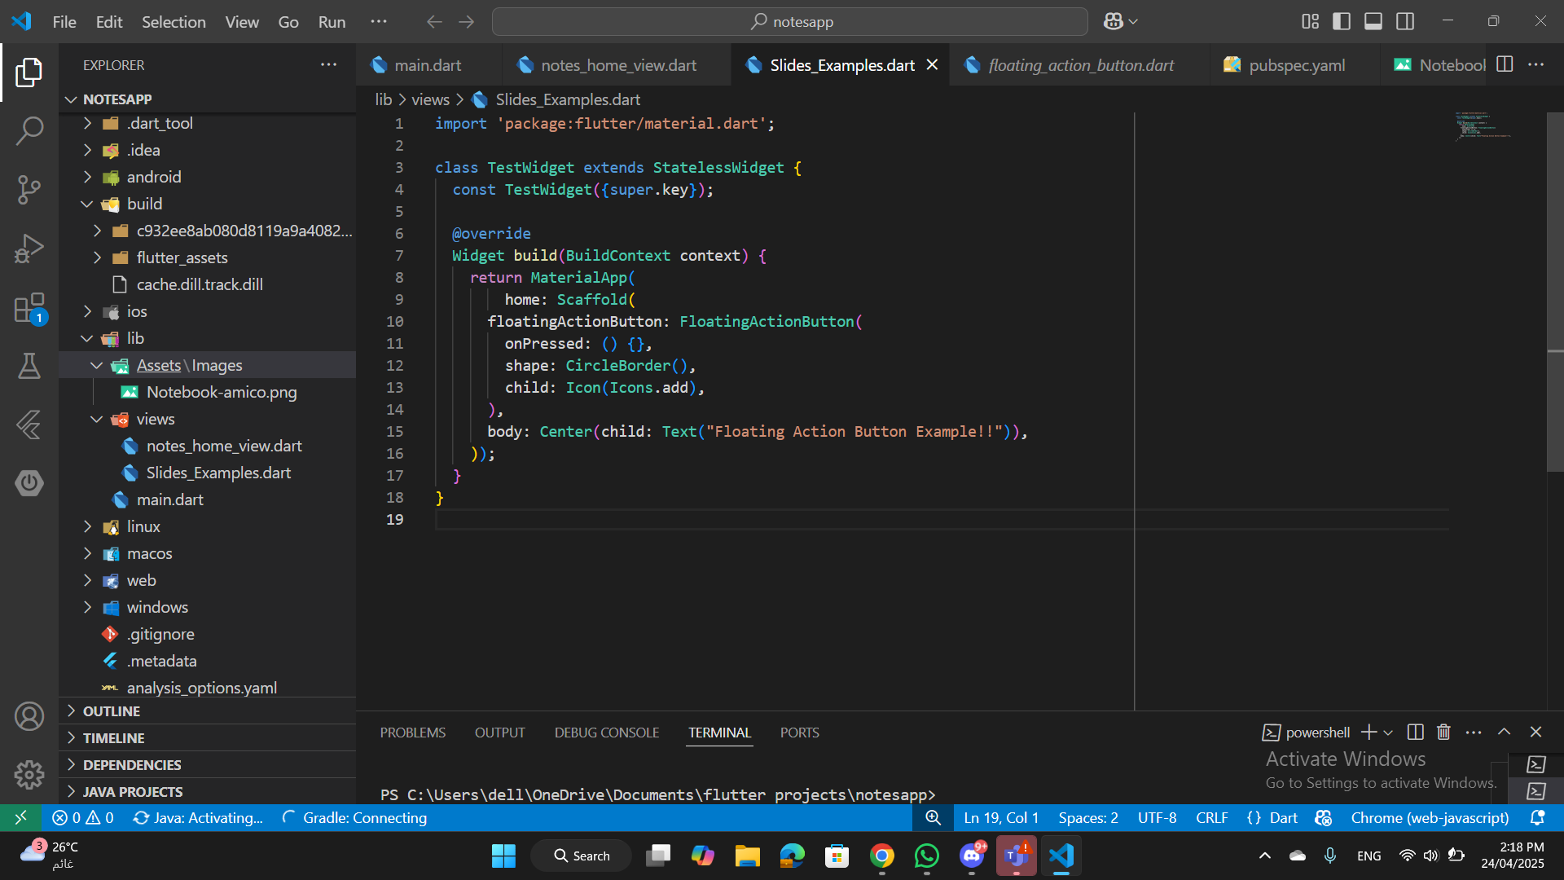
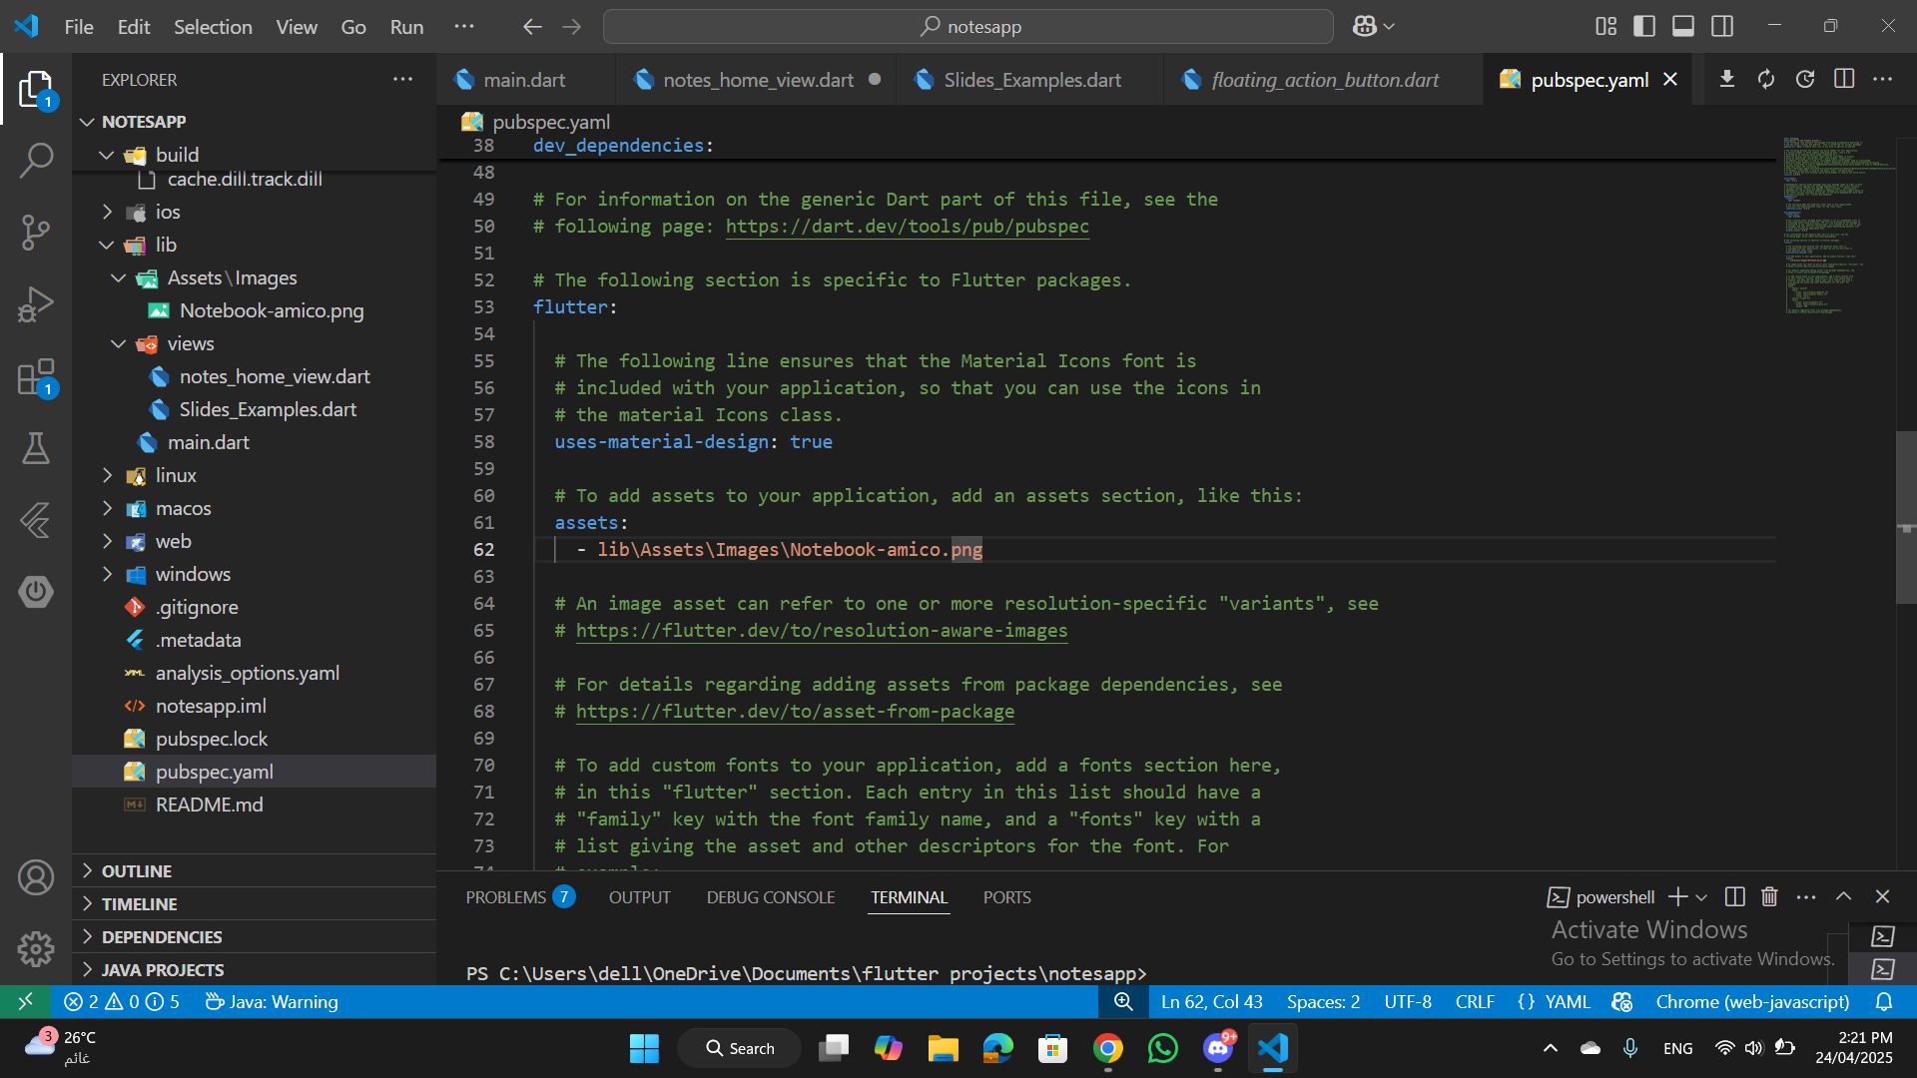
Assets
How to Use Assets in Flutter
1. Add assets to your project:
Place your assets in a folder (commonly named assets) at the root of your Flutter project.
S25' Training Sessions
2. Declare assets in pubspec.yaml:

Slide 14
Assets
S25' Training Sessions
Images

Slide 15
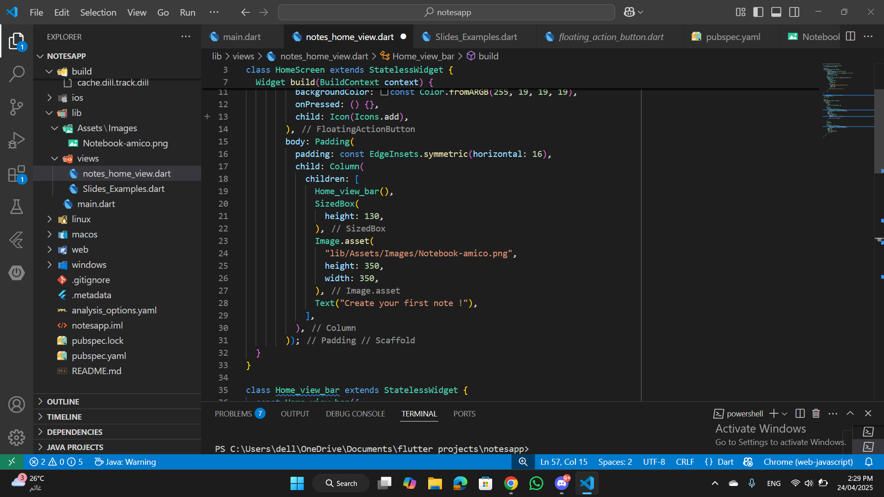
Assets
1.Asset Image
Place your image inside the assets/images/ folder.
Add the path in pubspec.yaml file
use Image.Asset Widget
S25' Training Sessions

Slide 16
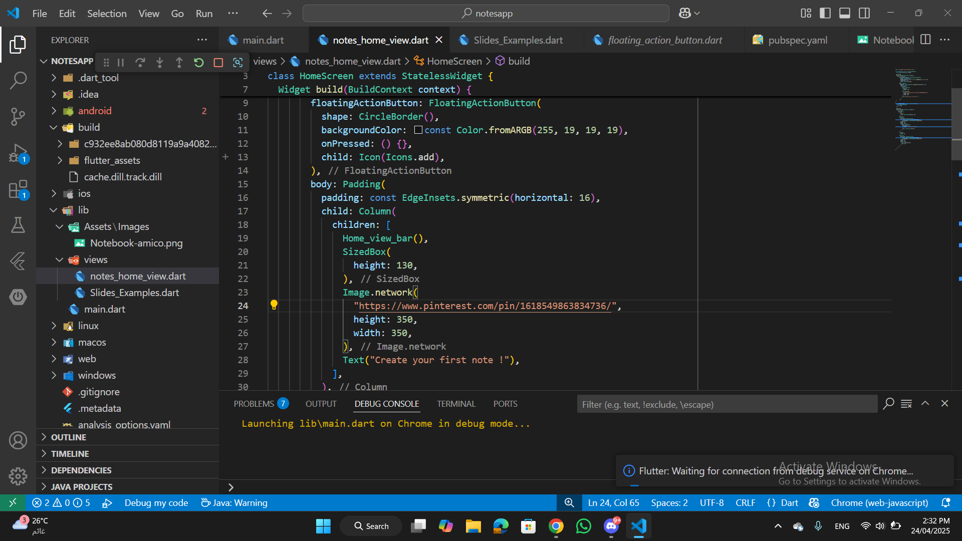
Assets
2.Network Image
use Image.network Widget
S25' Training Sessions

Slide 17
Assets
S25' Training Sessions
Fonts

Slide 18
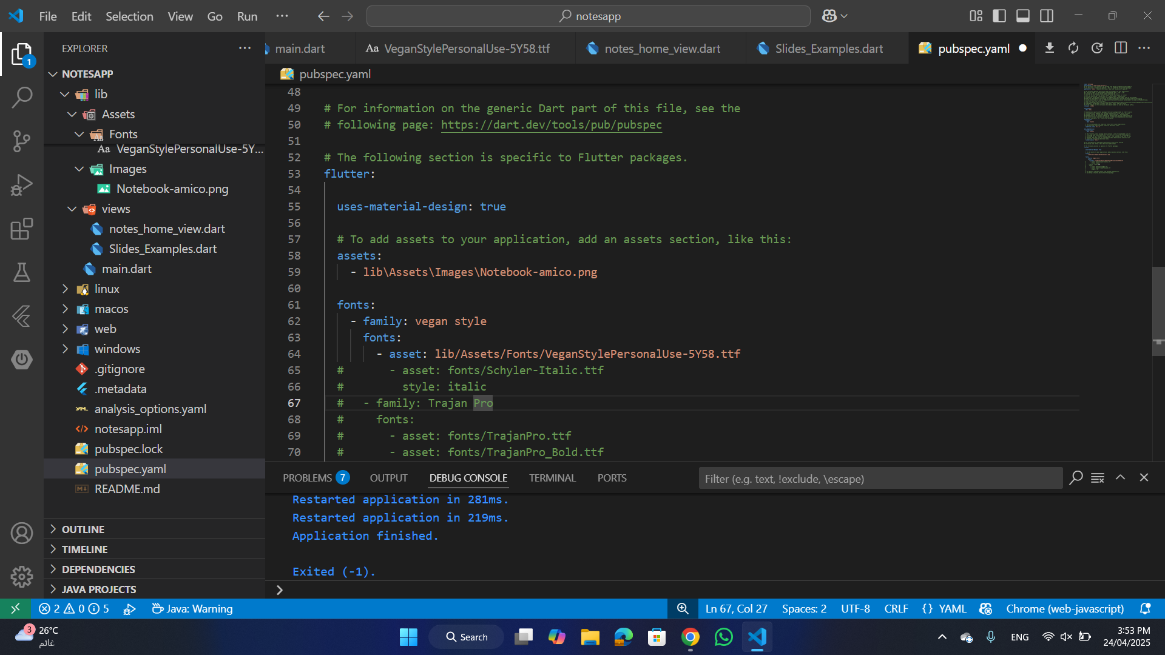
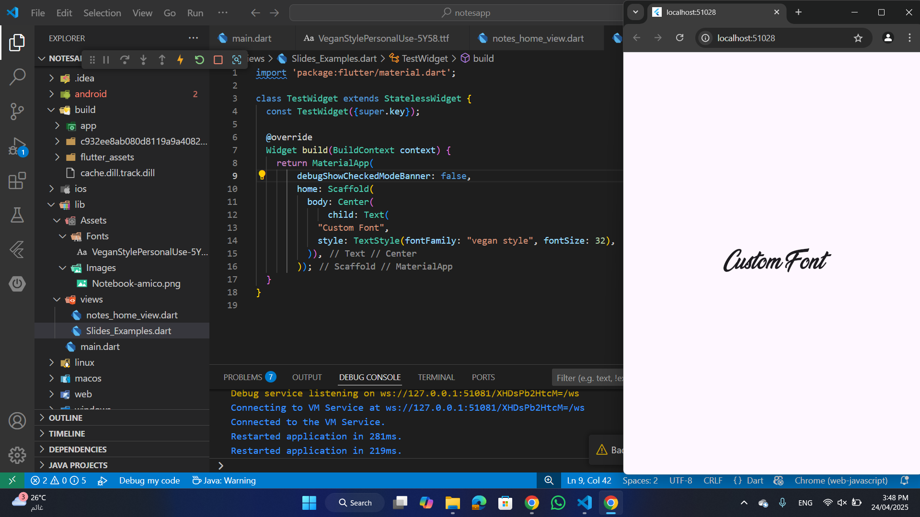
Assets
1.Custom Font
S25' Training Sessions
Place your image inside the assets/fonts/ folder.
Add the path in pubspec.yaml file
use Font family in TextStyle widget

Slide 19
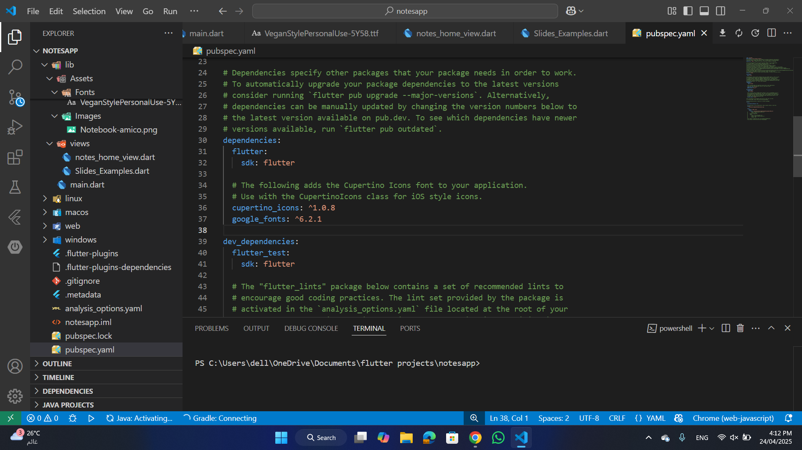
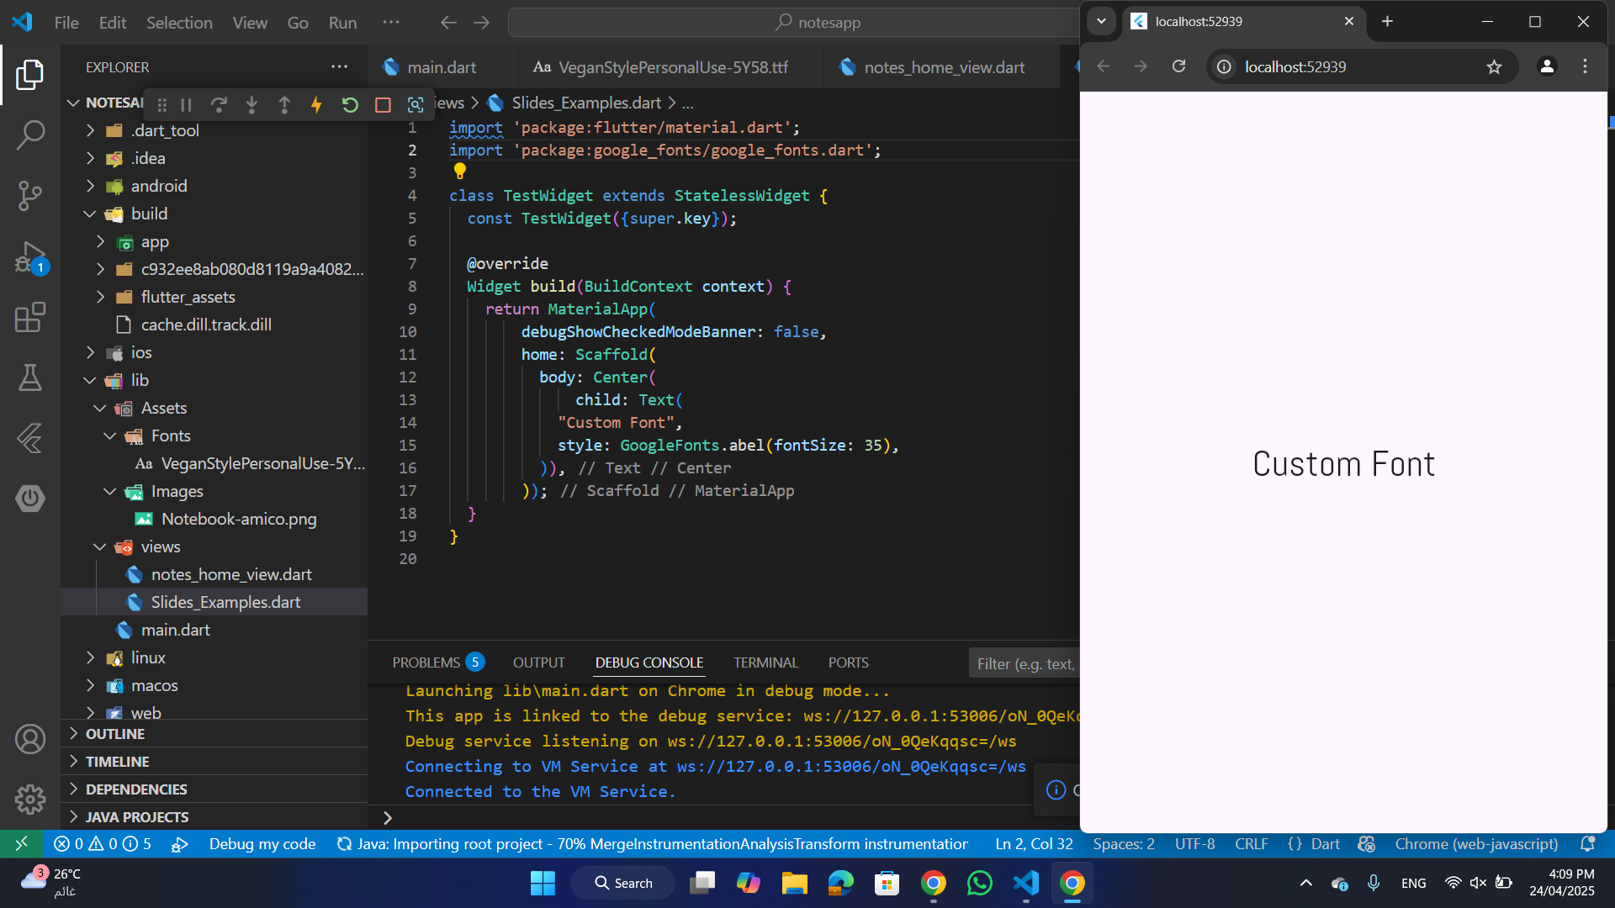
Assets
2.Google Fonts
S25' Training Sessions
Add the Google Fonts Package
import 'package:google_fonts/google_fonts.dart';
style: GoogleFonts.lobster( fontSize: 24, fontWeight: FontWeight.bold, color: Colors.blue, ),

Slide 20
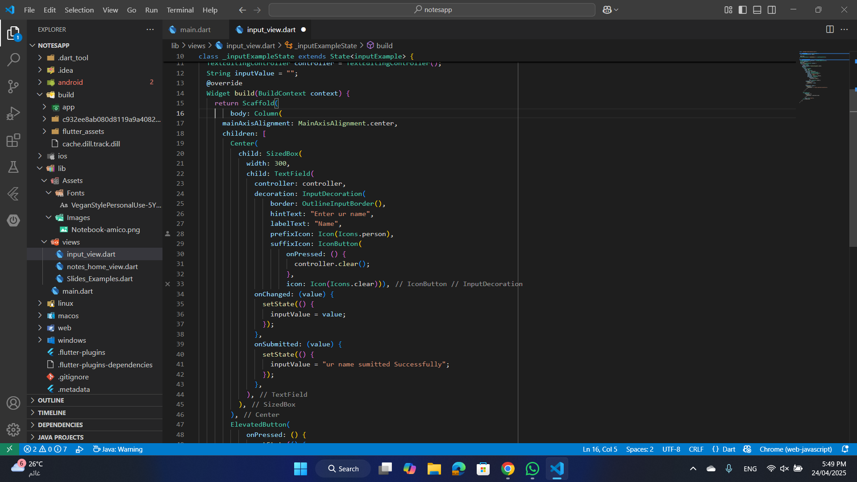
TextField
TextField
Allows user input in a form or any interactive UI element.
S25' Training Sessions
Key Properties:
controller: Manages text input.
decoration: Adds styling, like labels and borders.
onChanged: Callback when the text changes.

Slide 21
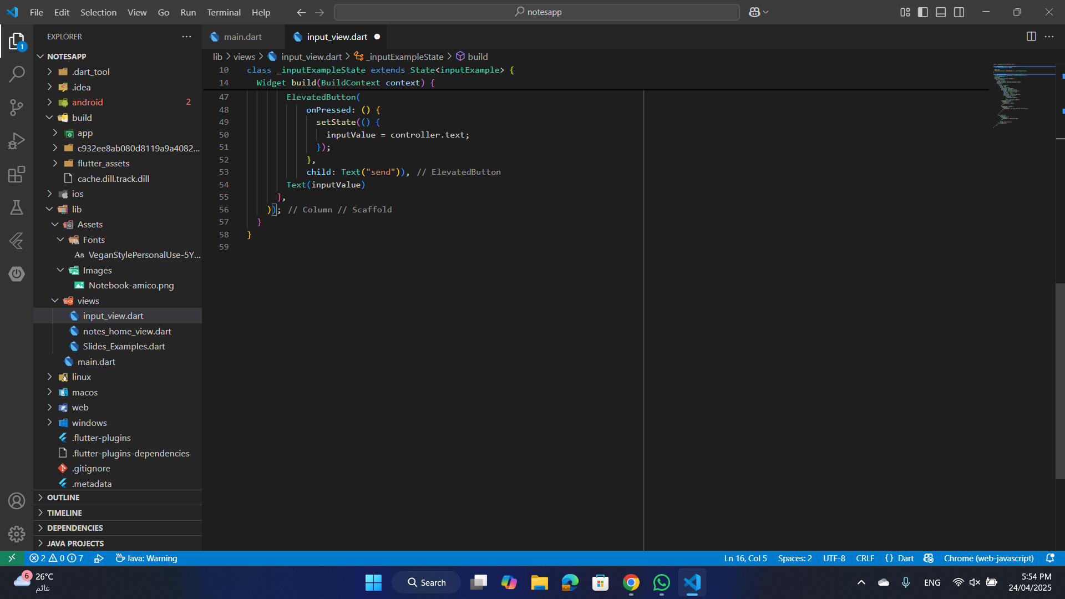
Statefull
setState in Flutter:
Updates the state of a StatefulWidget and triggers a UI rebuild.
S25' Training Sessions
Note:
Only works with StatefulWidget.
Call setState inside the widget's State class.

Slide 22
Exercise
S25' Training Sessions
Simple Calculator App

Slide 23

tHANK YOU
SEE YOU NEXT TIME
S25' Training Sessions

